Slide 1

UNIVERSITY INSTITUTE OF ENGINEERING
COMPUTER SCIENCE ENGINEERING
Bachelor of Engineering (Computer Science & Engineering)
Subject Name: Big Data Analytics
Subject Code: 20CST-471
MongoDB and Cassandra: Features and use cases
Mapped with CO3
Prepared By:
Er. Ankita Sharma
DISCOVER . LEARN . EMPOWER

Slide 2
MongoDB and Cassandra: Features and use cases
MongoDB supports dynamic schema, enabling developers to adapt their data models without the need for predefined schemas, making it well-suited for agile development environments.
Its indexing capabilities and rich query language facilitate efficient data retrieval, and the support for horizontal scaling across distributed clusters ensures high availability and fault tolerance.

Slide 3
MongoDB finds extensive use in a variety of applications, including content management systems, e-commerce platforms, and real-time analytics, where the ability to handle diverse and evolving data structures is crucial.
Its seamless integration with programming languages like JavaScript and Python contributes to its popularity among developers working on modern, dynamic applications.

Slide 4
Cassandra: Features and Use Cases:
Apache Cassandra, a prominent Column-family NoSQL database, stands out for its robustness in handling large-scale, distributed data with high availability and fault tolerance.
Cassandra's architecture is designed to scale horizontally, making it a go-to choice for applications dealing with massive amounts of data across multiple nodes.
It excels in write-intensive workloads, ensuring consistently high write throughput even in the face of rapid data growth.

Slide 5
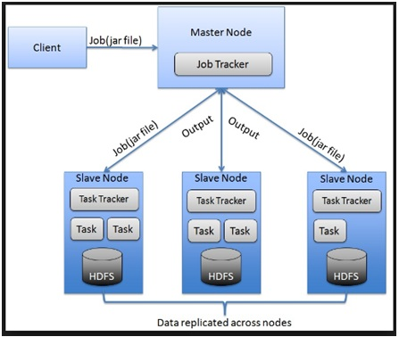

Slide 6
Cassandra's decentralized and peer-to-peer architecture minimizes points of failure, enhancing its resilience.
This makes it particularly suitable for use cases such as time-series data, sensor data, and applications requiring real-time data processing.
Industries such as finance, telecommunications, and IoT leverage Cassandra's capabilities to manage vast datasets efficiently and ensure seamless operation in dynamic, distributed environments.

Slide 7
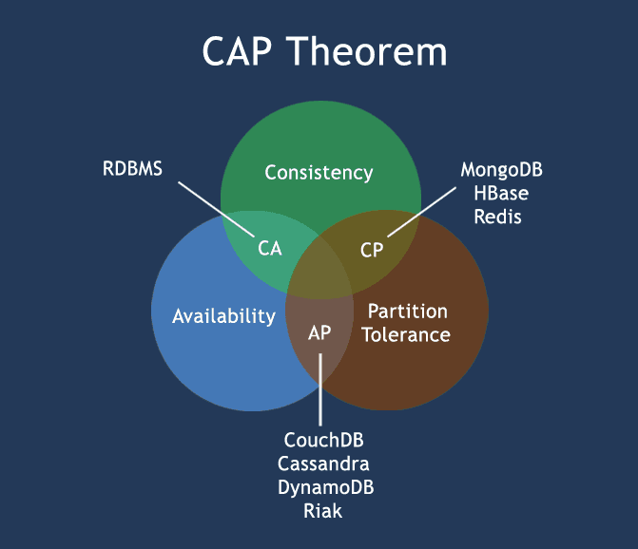

Slide 8
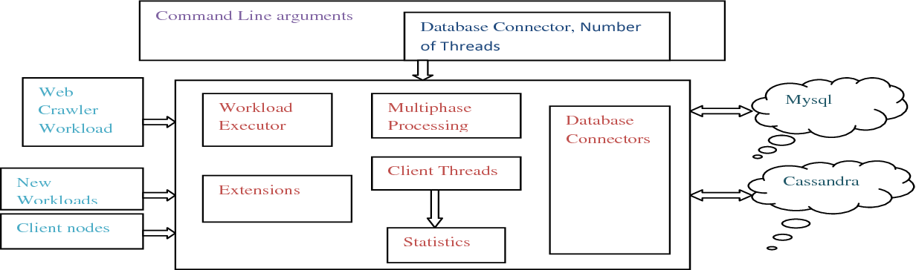

Slide 9
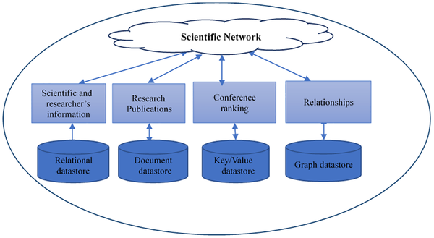

Slide 10
Thankyou

